Slide 1

Cloud Computing
UNIT – V

Slide 2
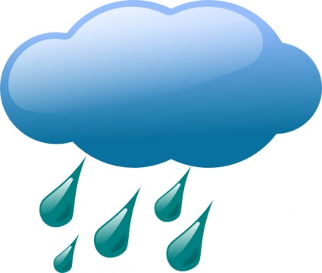
CLOUD OFFERING
UNIT-5

Slide 3
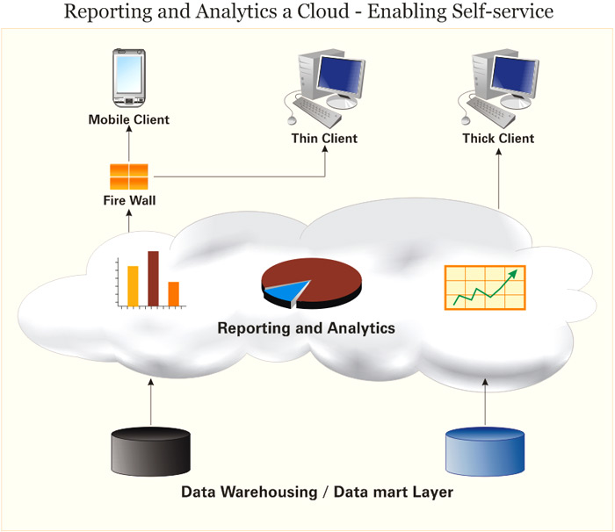
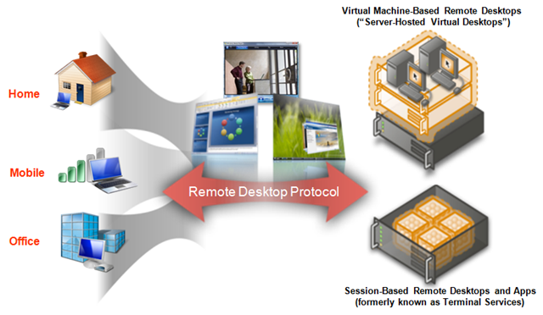
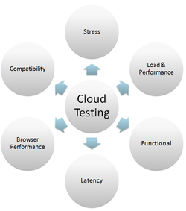
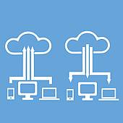
5. Cloud offerings
Chapter Topics
5.1 Introduction
5.2 Information Storage, Retrieval, Archive and Protection
5.3 Cloud Analytics,
5.4 Testing under cloud,
5.5 Information Security,
5.6 Virtual Desktop Infrastructure,
5.7 Storage Cloud.

Slide 4

5. Cloud offerings
5.1 Introduction
Information is pouring in faster than we can make sense of it. It is being authored by billions of people and flowing from a trillion intelligent devices, sensors and instrumented objects.
With 80% percent of new data growth existing as unstructured content from music files, to 3D images, to medical records, to e-mail keystrokes and more, the challenge is trying to pull it all together and make it useful.

Slide 5
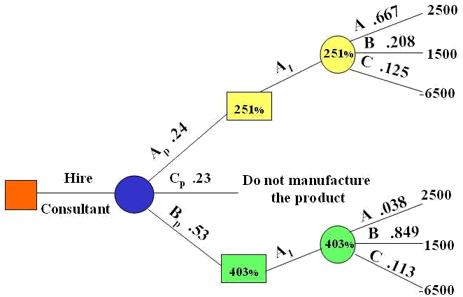
5. Cloud offerings
5.1 Introduction
Until now, organizations could not fully or quickly synthesize and interpret all the information out there- they had make decisions based largely on instinct.
But now, there is software that can capture organize and process all the data scattered throughout an organization, and turn into actual intelligence. This enables organizations to make better business decisions.

Slide 6
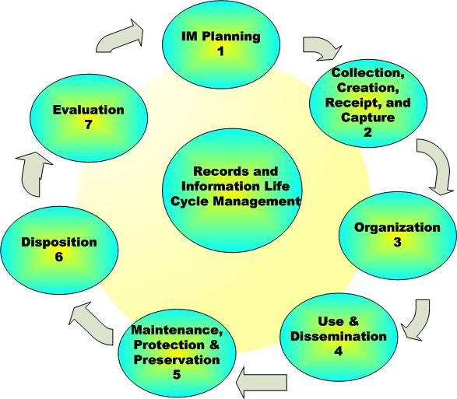
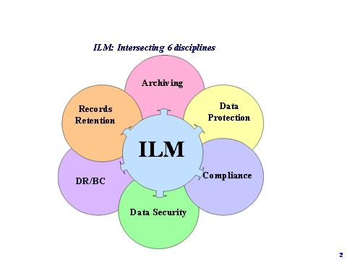
5. Cloud offerings
5.2 Information Storage, Retrieval, archive and protection
Organization process, manage, move, protect and archive various business data according to unique characteristics such as age, usage, patterns, compliance and archiving policies, security and disaster protection rules and values.
Information LifeCycle Management (ILM) is a growing concern and practice.

Slide 7

5. Cloud offerings
5.2 ILM Objectives
Cost reductions
Controlling demand for storage
Better system performance and personal productivity
Doing the storage activities “right”
Increased effectiveness
Doing the “right “ storage activities

Slide 8
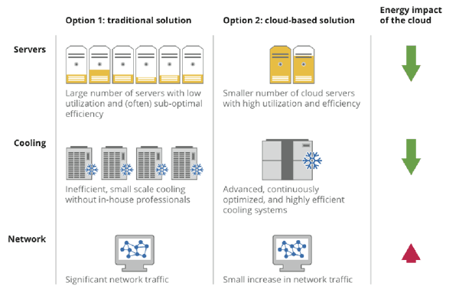
5. Cloud offerings
5.2 ILM Objectives
Ways to generate, enhance and sustain higher savings
Activities for gaining initial saving
Reduce the amount of used storage as a result of initial clean up
Activities for maximizing saving
Reconfigure the current storage environment effectively improving the available to raw utilization
Activities for sustaining savings
Develop storage architecture governance model

Slide 9
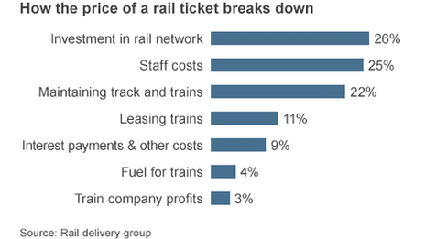
5. Cloud offerings
5.2 ILM Objectives
Cost Components
Operating cost categories
personal, facilities, storage hardware
maintenance, storage software
maintenance, outages
Investment cost categories
new hardware required, new software required, hardware refresh, transition services

Slide 10
5. Cloud offerings
5.2 Information Management Points
Data
Information
ILM
Information Taxonomy
Information Classes
Value Driven data Placement
Storage Process
Storage service
Enterprise Class of Service ( CoS)

Slide 11
5. Cloud offerings
5.2 Information Management points
Storage service
Enterprise Class of Service ( CoS)
Storage Tier
Tiered Storage Infrastructure
Utility based Service Delivery

Slide 12
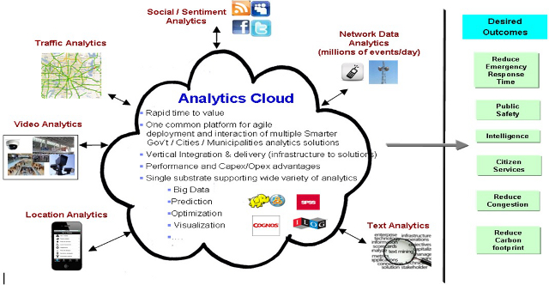
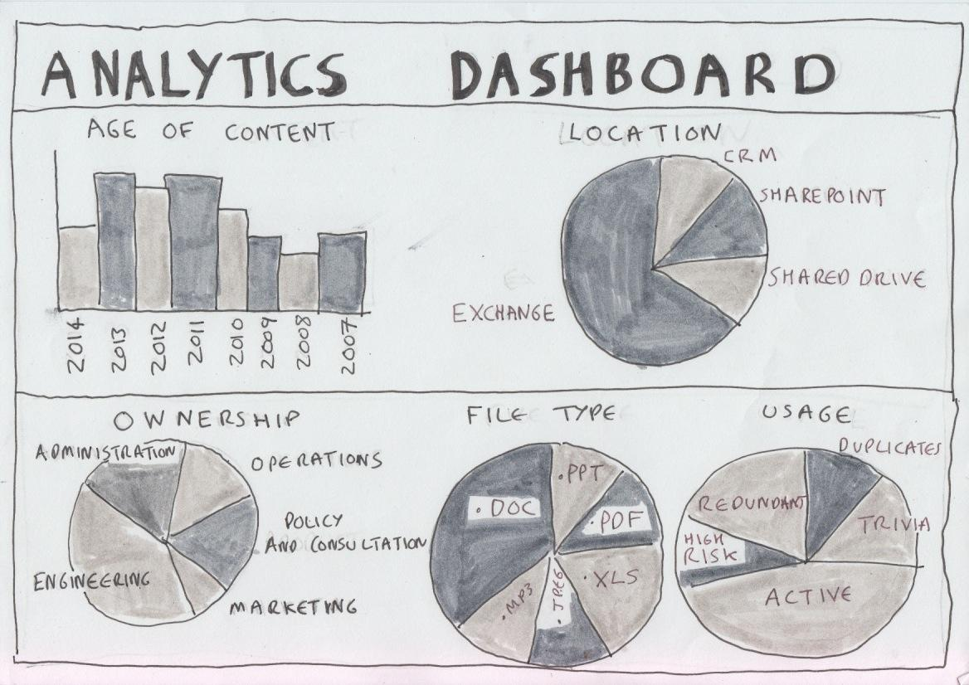
5. Cloud offerings
5.3 Cloud Analytics
Cloud analytics is the new offering in the new era of cloud computing.
This will help consulting domain and will ensure the better results.
It provides user with better forecasting techniques to analyze and optimize the service lines and provides a higher level of accuracy.

Slide 13
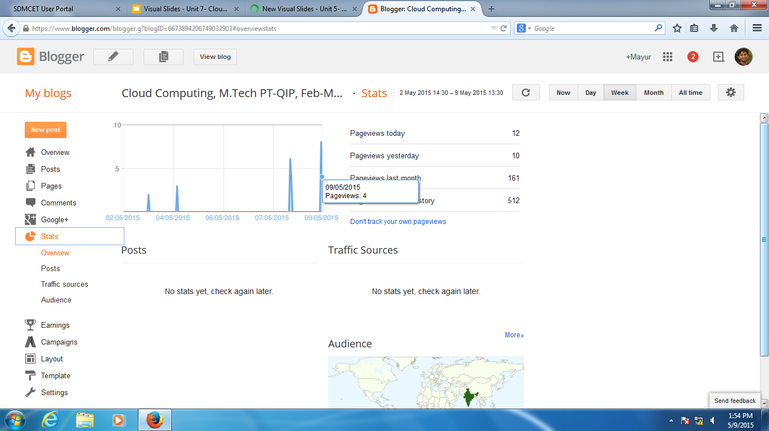

Slide 14
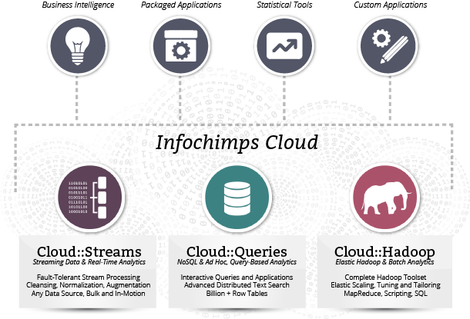
5. Cloud offerings
5.3 Cloud Analytics
It also helps to apply analytics principles and best practices to analyse different business consequences and achieve new levels of optimization.
This can combine complex analytics with the newer software platforms and will lead towards the predictable business out of every business insight

Slide 15
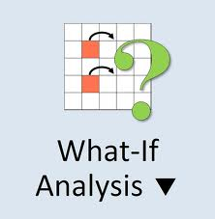
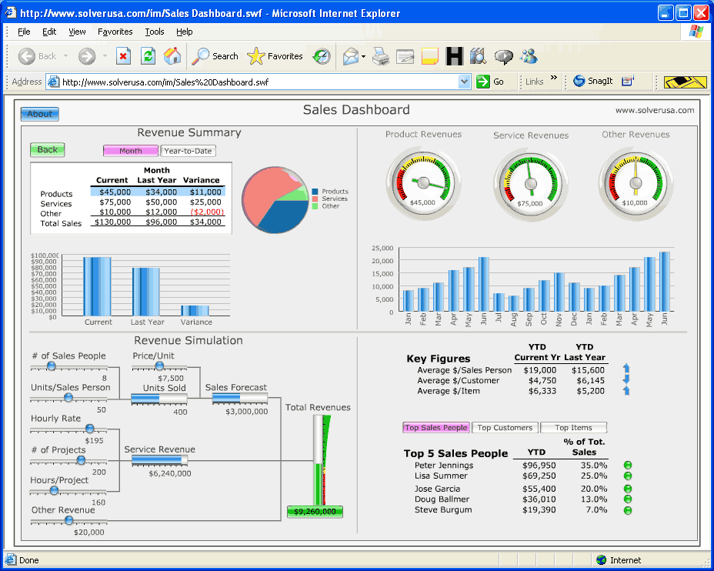
5. Cloud offerings
5.3.1 Cloud Business Analytics Competencies
Cloud analytics is supported by different types of competencies
Cloud Business analytics strategy that helps client Analytics and optimization - provides different type or modelling techniques, deep computing and simulation techniques to check different types of “ what if” analysis to increase performance.

Slide 16
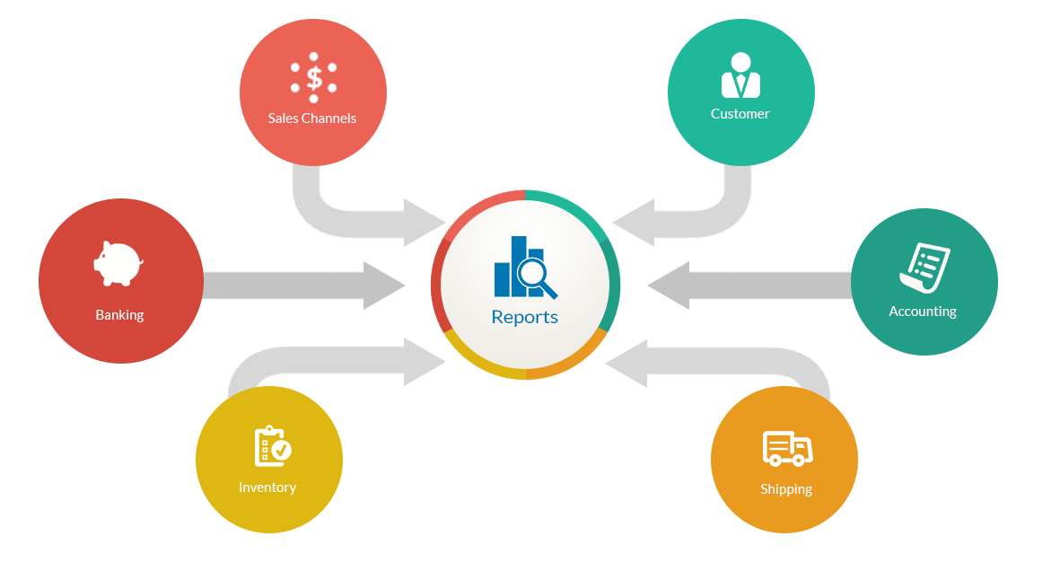
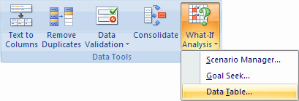
5. Cloud offerings
5.3.1 Cloud Business Analytics Competencies
2. Business management and performance management helps increase performance by providing accurate and on-time data reporting.

Slide 17
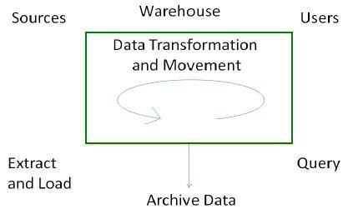
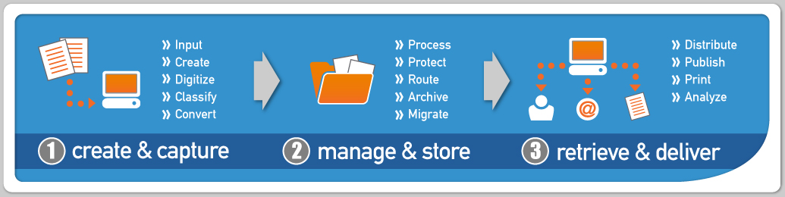
5. Cloud offerings
5.3.1 Cloud Business Analytics Competencies
Cloud analytics is supported by different types of competencies
3. Enterprise information management that lets the user to apply different architecture related to data extraction, archival, retrieval, movement and integration.
4. Content management that includes different service architecture, technology architecture and process related to capturing, storing, preserving, delivering and managing the data. It also provides access in the global environment and makes it easy to share data with stakeholders across the globe

Slide 18
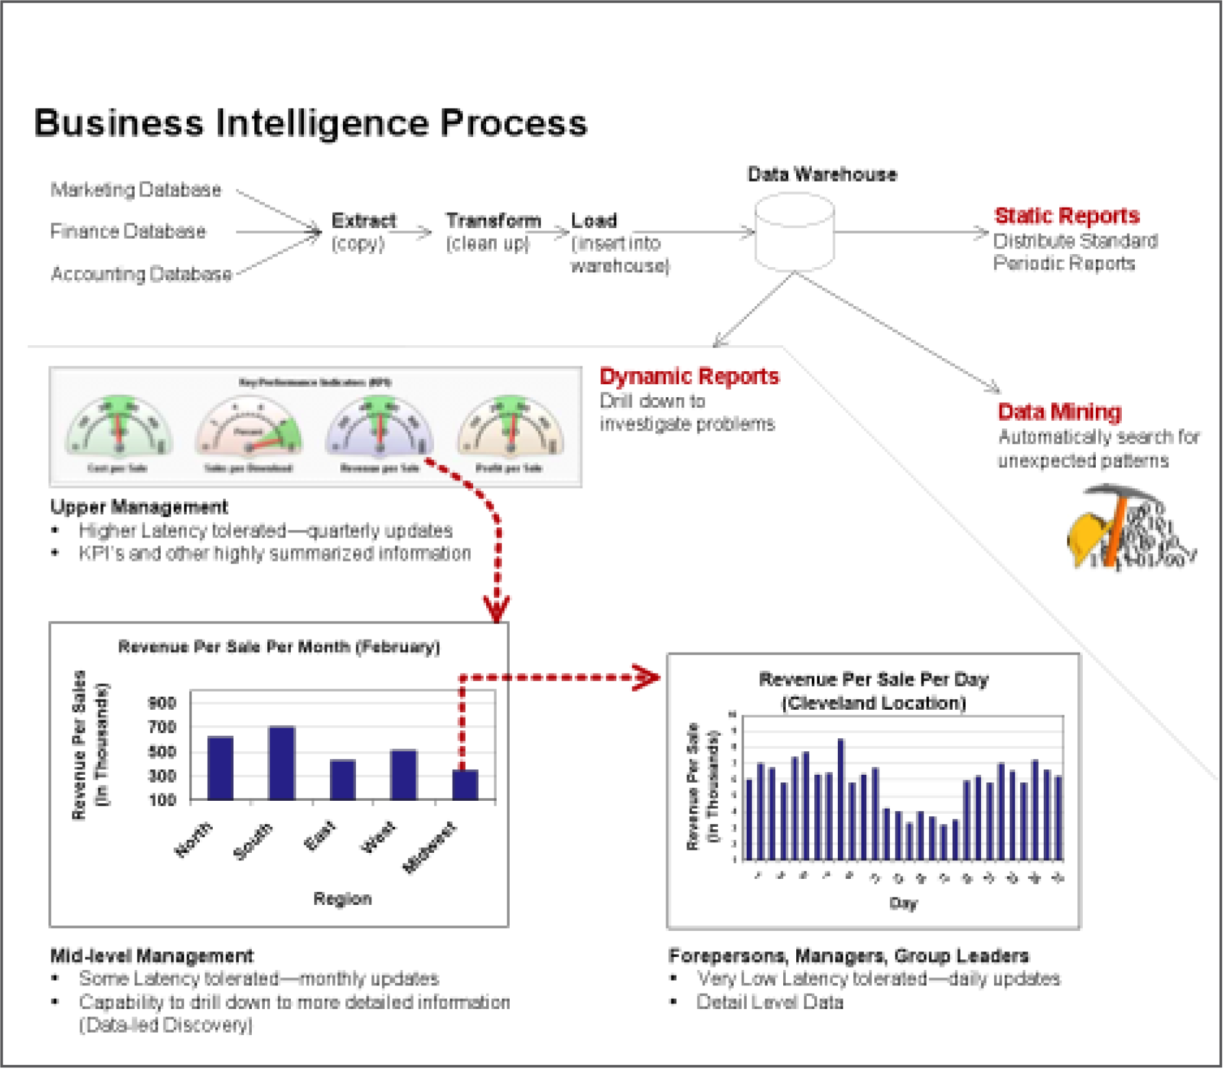

5. Cloud offerings
5.3.2 How it Works: Analytics
Analytics works with the combination of hardware, services and middleware. This expertise makes it best suited to help clients extract new value from their business information.
Delivering business analytics and information software requires a seamless flow of all forms of data regardless of format, platform and location.
Its focus on open industry standards is key to this effort, and gives us a significant advantages.

Slide 19
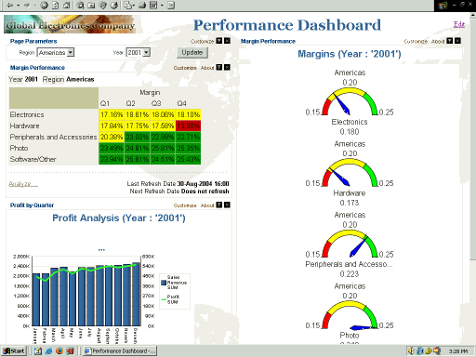
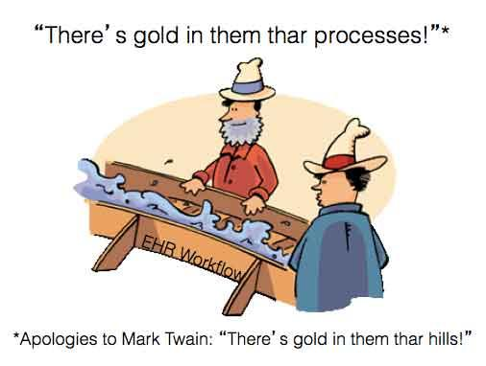
5. Cloud offerings
5.3.2 How it Works: Analytics
The system features include the platform that provides data reporting, analytics based on text, mining activities, business intelligence, dashboard and perceptive analytics techniques.
This also takes care of the storage optimization and different high-performance data-warehouse management techniques

Slide 20
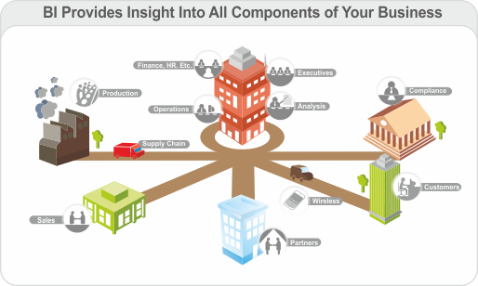
5. Cloud offerings
5.3.2 How it Works: Analytics
Analytics Business Outcomes
Analytics systems help to get the right information as and when required, identify how to get it and point out right sources to get it.
Therefore, analytics also helps in designing the policies faster based on the information available in the organization as decision-makers work with the exploration services available within the organization.

Slide 21
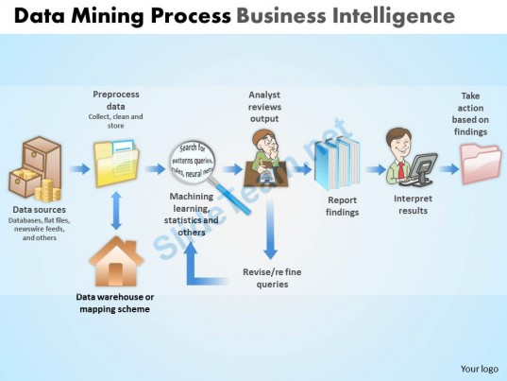
5. Cloud offerings
5.3.2 How it Works: Analytics
Analytics Business Outcomes
This also helps in gauging the business results by measuring the different metrics generated with the help of analytics.
This gives the option through which the organization can increase the profitability, reduces cycle times and reduce defects

Slide 22
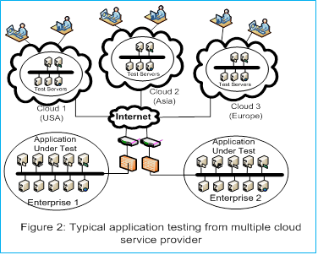
5. Cloud offerings
5.4 Testing under Cloud
Testing under cloud provides a good return on investment on moving typical testing environment to cloud.
It allows flexibility to play with the surrogate of the real system without the actual risk.

Slide 23
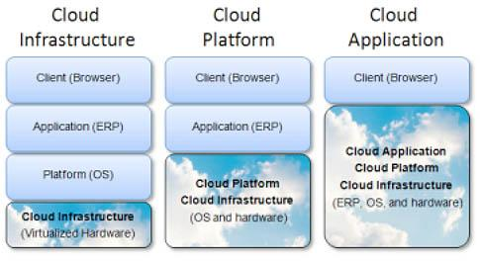
5. Cloud offerings
5.4.1 Benefits
Cut capital and operational costs and not affect mission critical applications.
Offer new and innovative services to clients, and present an opportunity to speed cycle of innovation and improve solution quality
Facilitate a test environment based on request and provide request-based service for storage, network and OS

Slide 24
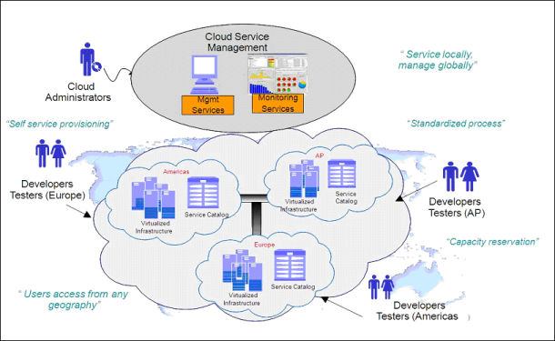
5. Cloud offerings
5.4.2 Value proposition
Business test cloud delivers an integrated, flexible and extensible approach to test resource services and management with rapid time to value.
This is an end-to-end set of services to strategize, design and build request-driven delivery of test resources in a cost-effective, efficient manner.

Slide 25
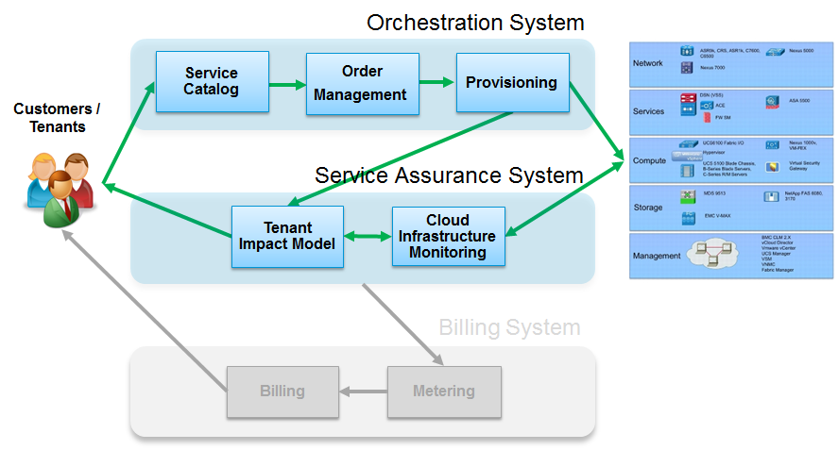
5. Cloud offerings
5.4.2 Value proposition
These test tools allow you to orchestrate and build your services and development projects and allow you to catalogue and organize all of the various software assets that you have.
These can be administrators, development team leads or project team members that you give permission

Slide 26
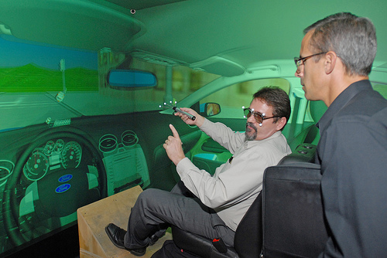
5. Cloud Offerings
5.4.3 Biggest Benefitters
With ability to deploy virtual environments quickly and automatically and redirect capacity as needed, cloud computing offers an ideal solution for testing and development.
Virtual environments provide the sensory experience of being in a computer generated, simulated space.

Slide 27
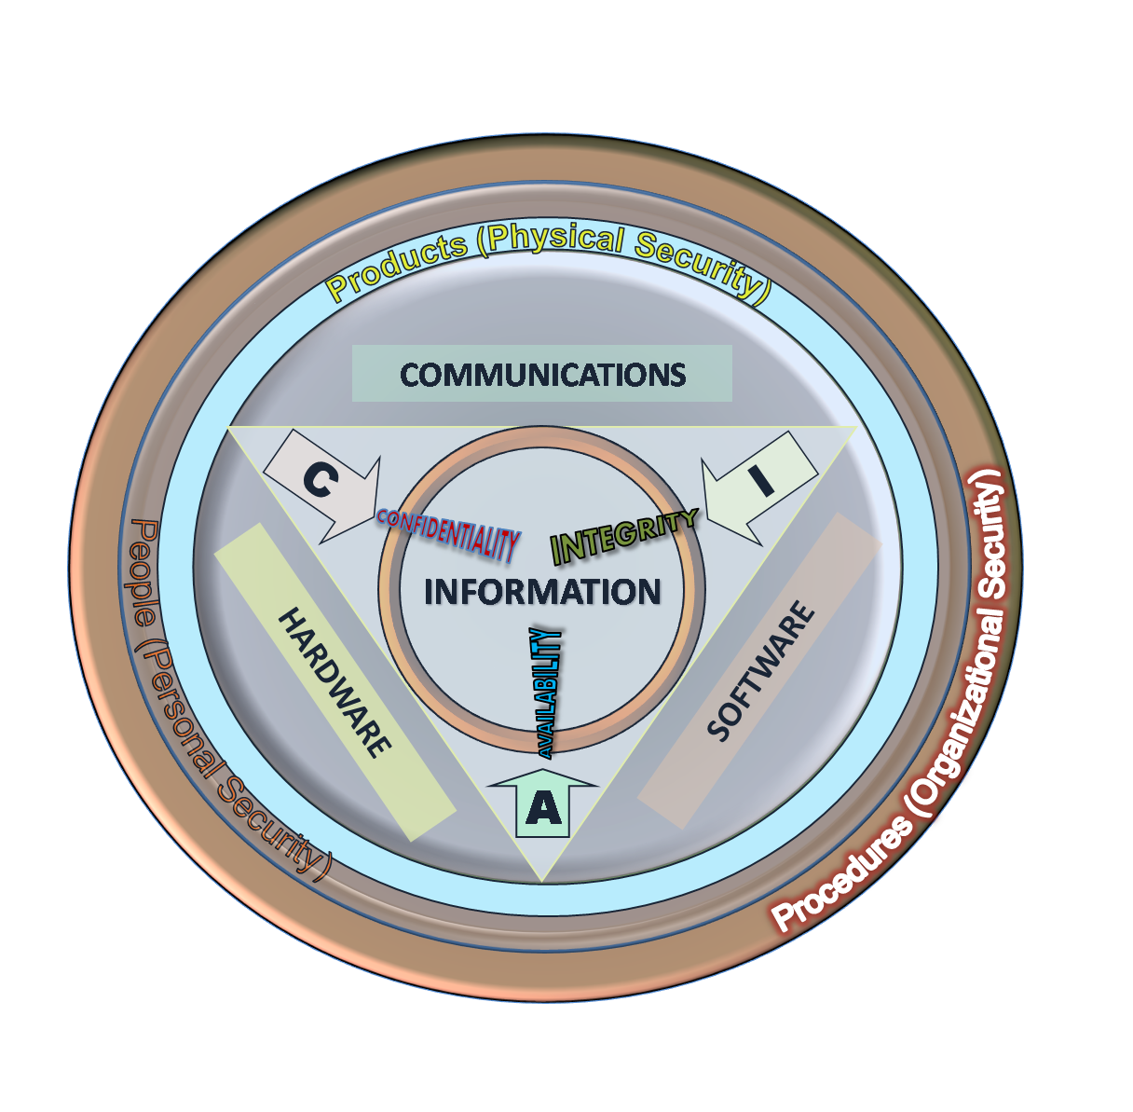

5. Cloud offerings
5.5 Information Security
Information security risks are potential damages to information assets. Successful organizations take a risk-based approach to information security
Risk can be quantified by expected damage:
Value of asset
Vulnerabilities
Threats

Slide 28
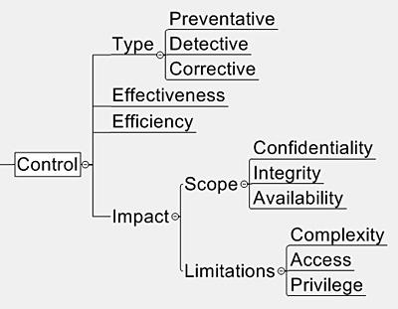
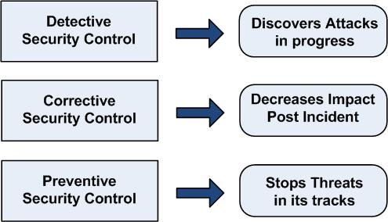
5. Cloud offerings
5.5 Information Security
Security controls are safeguards or countermeasures to avoid or minimize information security risks:
Must be effective- mitigate the give risk
Should be adaptive: Adapt to changing risks
Three main types of controls
Preventive
Detective
Corrective

Slide 29


5. Cloud offerings
5.5.1 Expectation of Privacy
Consumer expectation is that security should be built into services themselves. Large number of potential cloud consumers still avoid purchases due to fear of financial information being stolen. Expectation drives regulation.
Enterprises must shore-up their weakest supply chain partners:
more evenly distributed security responsibilities
increased transparency from the start to finish
Erased burden of customer-facing unit

Slide 30
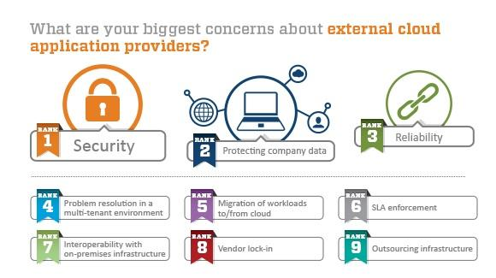
5. Cloud offerings
5.5.2 Security Challenges
5.5.3 Security compliance
need for policies and procedure to meet compliance requirement - medical
5.5.4 Identity-based protection
identifying true and authentic user
5.5.5 Data Protection @ Cloud
5.5.6 Application Security @ cloud deployment

Slide 31
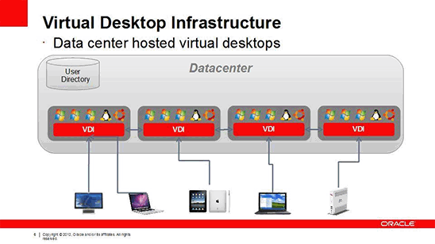
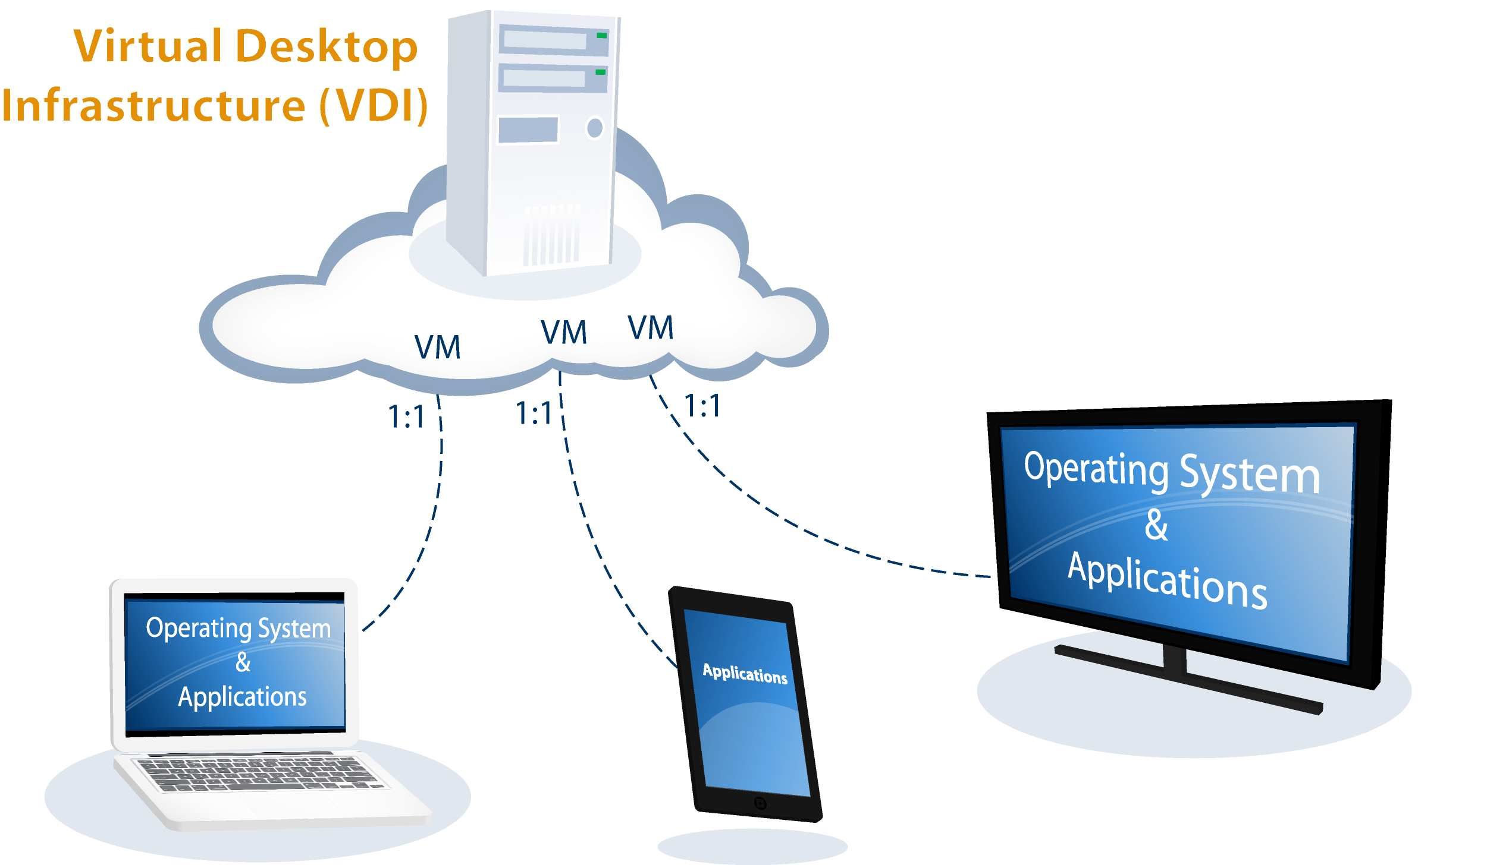
5. Cloud offerings
5.6 Virtual Desktop Infrastructure
Virtual desktop infrastructure provides end-user virtualization solutions.
This is designed to help transform distributed IT architectures into virtualized, open-standard-based framework leveraging centralized IT services.
The notion behind the virtual desktop infrastructure is to run desktop operating systems and applications inside virtual machines that reside on the servers in the data center. This is called Virtual desktop. User access a Virtual desktop through their desktop PC.

Slide 32
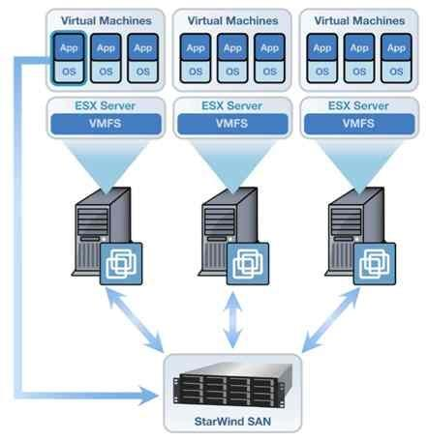
Server Virtualization
Server virtualization is the masking of server resources, including the number and identity of individual physical servers, processors, and operating systems, from server users. More

Slide 33
5. Cloud Offerings
5.6 Virtual Desktop Infrastructure
VDI delivers solution that
consists of optional portal interface, thin-client and PC with client components or web browser.
delivers a common, standard-based, resilient IT infrastructure that is security-rich , scalable and provides single-point, consistent access from a wide choices of client devices.

Slide 34
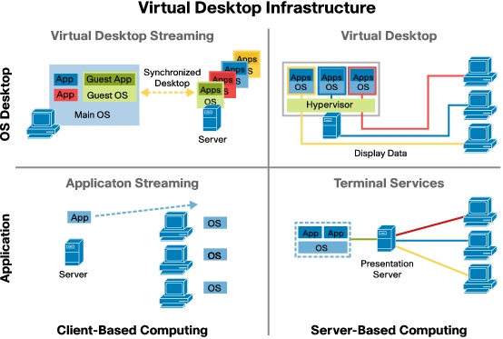
5. Cloud offerings
5.6.1 Architecture Overview
Virtual Desktop Infrastructure creates a framework that offers many advantages:
cost reductions
flexibility
security
availability
efficiency

Slide 35
5. Cloud offerings
5.6.2 Enterprise Level
VDI provides a enterprise level or grade solution.
It introduces a new method of delivering and managing user desktop environments.

Slide 36
5. Cloud offerings
5.6.3 Client access
Virtual Desktop manager ( VDM) helps user to connect their desktop to servers
5.6.4 Desktop Virtualization services
5.6.5. Desktop Management
5.6.6. Pool Management for VDI

Slide 37
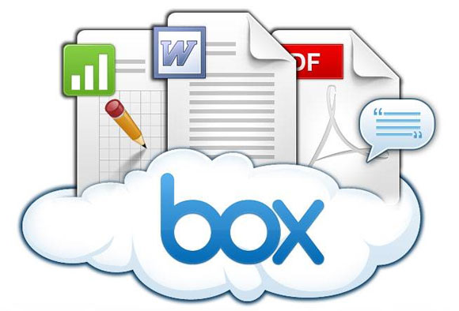
5. Cloud offerings
5.7 Storage cloud
Storage management in cloud can help organizations to address their challenges around data and storage management in their clouds :
Availability of data at all times
Storage resource and utilization
Application performance
Longer restore times
Higher storage costs
Low productivity of storage personnel
Increased risk of data loss and downtime

Slide 38
5. Cloud offerings
5.7.1 Value proposition
5.7.2 Challenges
data availability, security
5.7.3 Business Drivers
5.7.4 Benefits
5.7.5 Product/Solution overview
5.7.6 Product/solution description

Slide 39
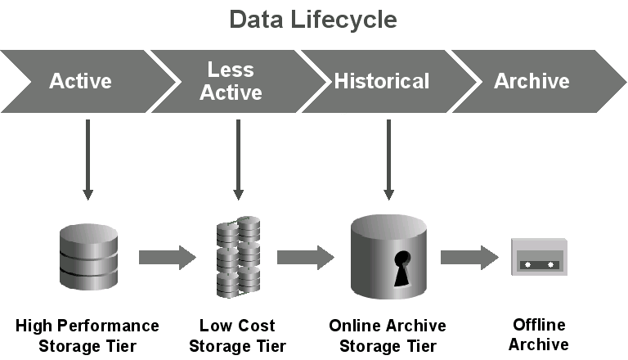
5. Cloud offerings
Chapter Summary
Managing data in the connected world poses a challenge for all enterprises.
The challenge of storage environment- storage, backup and recovery, archiving, expiration, and storage resource management and exploding.
It is not just enhancing storage capacity but managing entire information lifecycle management.

Slide 40

Thanks to -
1) Dr. Kumar Saurabh
2) http://cloudcomputing4postgraduates.blogspot.in/
3) Google Images

